Slide 1
Building a Naive Bayes Model using KNIME, Python and MLLIB on Spark.
Let's talk TensorFlow.
Jimmy Koyan
Big Q Labs
June 15th 2016 , Presenting at AHUG.

Slide 2
Objectives
Learn the ropes of ML with a Classification Algorithm - Naive Bayes
Mechanics of Naive Bayes.
Use KNIME to build a Naive Bayes statistical model in minutes
Spark - Let’s take a look at building the model on Spark using MLLib
TensorFlow

Slide 3

Probability Theory 101 :)
Flip a fair coin once , what’s the probability that we get heads :
P(H) = 0. 5
How about tails P(T) = 1 - P(H) = 0.5
How about if the coin is loaded and the probability of a heads on a toss is 0.8, whats the probability of getting a tail when you flip a coin
P(T) = 1 - P(H) = 1 - 0.8 = 0.2
Picture courtesy - http://www.emofaces.com/

Slide 4
? P(H,H) for a loaded coin when flipped twice
Flip a loaded coin once , what’s the probability that we get heads :
Where P(H) = 0.8 P(T) = 1 - P(H) = 0.2
Flip 1 | Flip 2 | Product | Probability of event
T | T | 0.2 x 0.2 | P(T,T) = 0.04
T | H | 0.2 x 0.8 | P(T,H) = 0.16
H | T | 0.8 x 0.2 | P(H,T) = 0.16
H | H | 0.8 x 0.8 | P(H,H) = 0.64
 |  | Total Probability P = | 1
Notes:
So let’s explore the probabilities of different scenarios when you flip a loaded coin twice, the question I want to specifically ask is what’s the probability of getting two heads at the same time when you flip the coin twice. We want to do this to build an intuition.

Slide 5
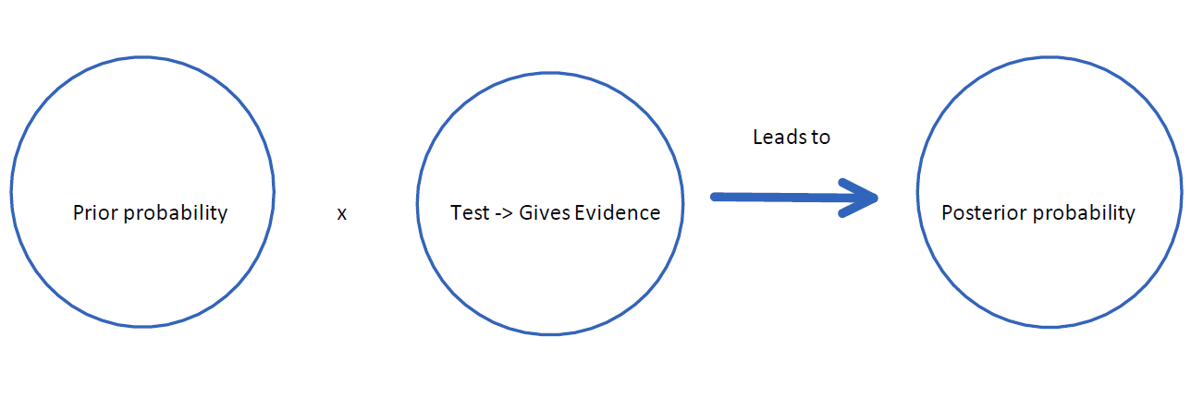
Naive Bayes Theorem Explained
Reverend Thomas Bayes was an English statistician and Presbyterian minister who is credited for formulating the Naive Bayes Theorem.
Fundamentals of Bayes Rule :

Slide 6
Examples
Let’s take a look at an example to explore Naive Bayes in Operation :
A certain type of Cancer C that occurs in about 1 % of the population.
Cancer occurs in 1% of Population | People with P(C) = 0.01 | People without Cancer P(>C) = 1 - P(C) = 0.99
Sensitivity (+ve test for Cancer) | 90 % i.e. P(P| C) = 0.9 | P(N| C) = 0.1
Specificity (-ve test for Cancer) | 90% i.e. P(N| >C) = 0.9 | P(P|>C) = 0.1

Slide 7
Examples
Given the data what’s the probability that a person has cancer given a positive test:
?? P(C | P)
? P(P , C) = P(C) x P( P | C) = 0.01 x 0.9 = 0.009
? P(P, >C) = P(>C) x P(P | >C) = 0.99x0.10 = 0.099
?Total Probability for cancer and non cancer for a +ve test
P(P) = 0.009 + 0.099 = 0.108 (also called the evidence)
4. P(C | P) = 0.009 / 0.108 = 0.0833 = about 8.3 %
5. P(>C | P) = 0.099 / 0.108 = 0.9166 = about 91.66 %

Slide 8
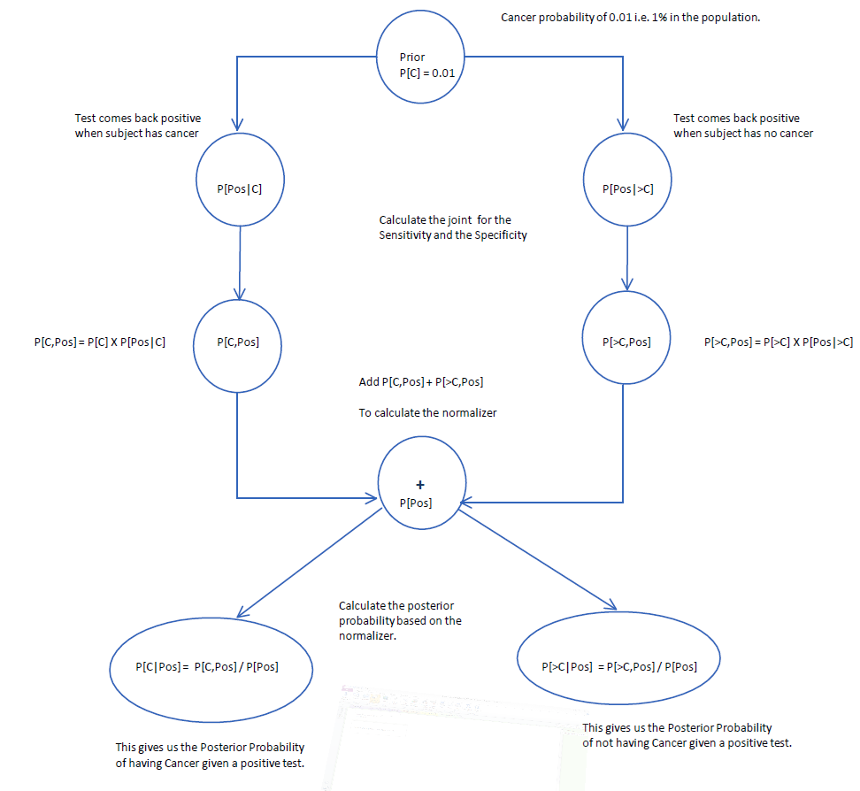
Examples

Slide 9
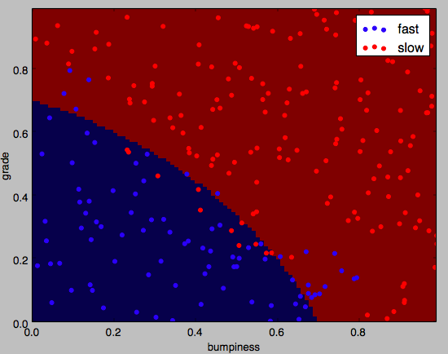
Classification algorithms create a Decision surface
Scatter Plot -
Plotting features of the conditions of the road
The output are two class labels - drive fast
- drive slow
Notes:
Classification Algorithms create a decision boundary to classify\categorize data points and assign class labels as output to the data points.

Slide 10
PP(Fast) = P(grade | Fast) * P(bumpiness | Fast) * P(Fast)
PP(Slow) = P(grade | Slow) * P(bumpiness | Slow) * P(Slow)
P(Fast) = PP(Fast)/ (PP(Fast) + PP(Slow))
P(Slow) = PP(Slow)/ (PP(Fast) + PP(Slow))

Slide 11

Using scikit sklearn to develop a NB model
Notes:
Using a NB Classifier to create a decision surface based on two features the grade(slope) and the bumpiness of the road. Its a generic model that could be used by a Self Driving car to make a decision on how fast should the car accelerate depending on the road conditions.

Slide 12

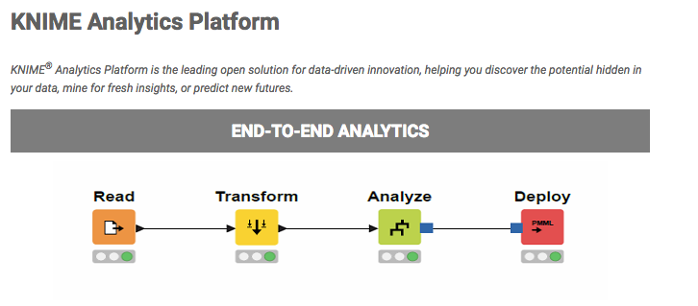
www.knime.org

Slide 13
Why Knime
Build a Statistical Model in minutes without programming
Advanced Predictive algorithms
Support for all major file formats and databases
Math and Statistical functions
Workflow control

Slide 14

Once you have tested and developed a ML model, it’s time to deploy it.
Spark is an excellent candidate because of its performance and fault tolerant design.
MLlib is Sparks scalable machine learning library
Language choice - Develop the model in Java, Scala, Python or SparkR

Slide 15
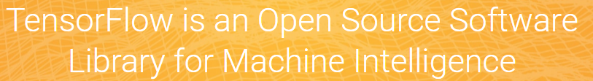
Open source software library for numerical computation using data flow graphs.
TensorFlow was originally developed by researchers and engineers on the Google Brain team to narrow the gap between research ideas and productization of the ideas.
Currently used for research and in production including :
Search
Gmail
Speech recognition
Advertising
Photos
StreetView - Blurring out house numbers
Translate
Youtube

Slide 16
TensorFlow: Architecture
Python
Frontend
C++
Frontend
...
TensorFlow Core Execution Engine
CPU
GPU
Android
iOS
….

Slide 17
TensorFlow: Under the Hood
TensorFlow allows very flexible structures and optimization
Computation is defined as a directed acyclic graph (DAG) to optimize an objective function.
General procedure
Graph is defined in high-level language such as Python
Graph is compiled and optimized
Graph is executed in parts or fully on available low level devices (CPU, GPU)

Slide 18
Computation is a Dataflow graph
Graph of Nodes, also called operations (ops)
biases
Add
Softmax
weights
Xent
MatMul
inputs
targets

Slide 19
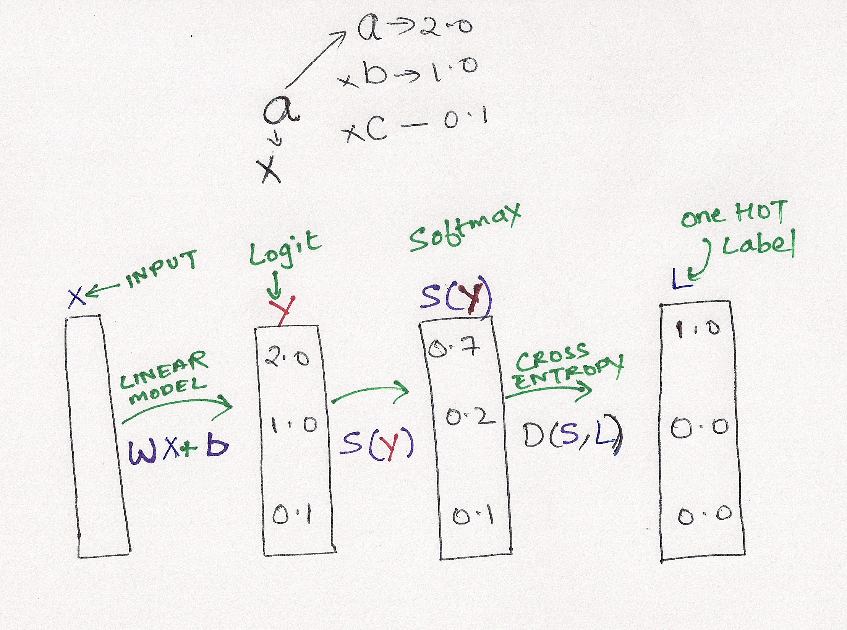
Logistic Regression - Flow Diagram

Slide 20
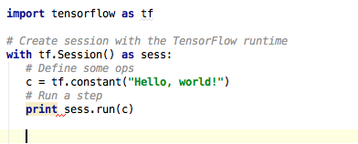
TensorFlow: Hello world

Slide 21
Final Notes:
Any questions reach me out to jimmy.koyan@bigqlabs.com
Credits -
Naive Bayes Examples from Udacity’s Machine Learning Course
TensorFlow Logistic Regression Diagram - Udacity’s Deep Learning Course
Rajat Monga’s talk on youtube - https://www.youtube.com/watch?v=wmw8Bbb_eIE
Scaling Tensorflow on Spark - http://www.slideshare.net/arimoinc/distributed-tensorflow-scaling-googles-deep-learning-library-on-spark-58527889

